Slide 1

multimodal InDoor localization
Kevin Leung Ko Tsun
ktleungai@connect.ust.hk
20516287
COMP4971C Independent Study

Slide 2
contents
Framework
Literature Review
Implementations
Experimental Results

Slide 3
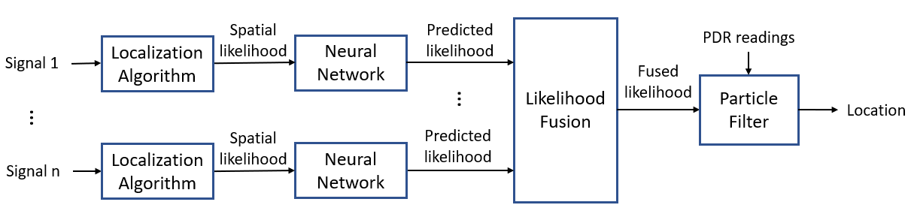
Sifu framework
Implement and improve multi-modal signal fusion localization framework(siFu)
Common problem localization: Difficult to combine the strength of multi-modal while mitigating their weakness
siFU features: Oovercoming the challenge by enabling signal addition and removal continuously, resulting in incrementally extensibility to new signals without retraining the whole system
Kevin’s duties
Improved the accuracy of the siFu framework by integrating a data augmentation module and modifying the model architecture
Consolidated literature review, implementation of the data augmentation module and obstacles
Notes:
tolerance -> since it is prob, can accommodate presence/absence of signal & missed signal values
weighted-> give different weigt to different signal according to their accuracy, adopting Bayesian model,

Slide 4

Literature review

Slide 5
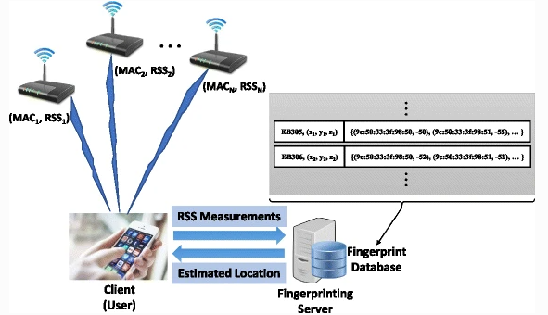
Literature Review – Fingerprint - Amplitude-Feature Deep Convolutional Generative Adversarial Network (AF-DCGAN) model
Fingerprint-based localization consists of two fundamental phases:
an offline phase (collect data at each reference point to construct the fingerprint data and train the classification model for the online phase)
an online phase (receive data online, compare the received data with the fingerprint database to achieve localization)
Major Challenge
Collecting adequate data at multiple reference points to ensure accuracy, which involves significant time, effort and resource.
Hence, it is hard to determine the volume of data needed to obtain during the offline phase
Wi-Fi fingerprinting procedure
AF-DCGAN Solution
Use generative adversarial nets to increase the training CSI data
AF-DCGAN and training algorithms are used to generate additional amplitude feature maps of the sampling points’ positions
Notes:
using the retrieved Wi-Fi RSS values and the corresponding MAC addresses of routers.

Slide 6
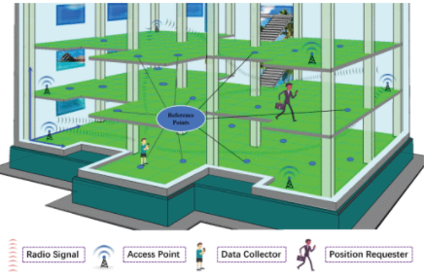
Literature Review – Wi-fi fingerprinting based on deep neural networks
Deep neural networks(DNN)
Performs floor classification and floor-level position estimation based on Wi-Fi fingerprinting
Major Challenge
Random fluctuation of a signal, the noise from multipath effects, and the device & position dependency in received signal strengths measurements
Scalability of fingerprint techniques
The scalability of fingerprint techniques becomes an important matter if the indoor location covers a large building complex, like a large shopping center or a university campus where many buildings are operated under the same management
Fingerprinting based indoor localization scenario
Stacked self-encoder
DNN's architecture consists of the stacked self-encoder (SAE) to reduce the space dimension of the features and a multi-label feed classification classifier to determine and evaluate the efficiency of the building-floor and floor levels
Notes:
using the retrieved Wi-Fi RSS values and the corresponding MAC addresses of routers.

Slide 7
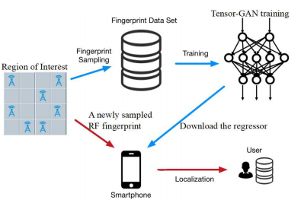
Literature Review – Radio frequency(RF) fingerprint-based localization - Tensor generative adversarial net
Radio Frequency Fingerprint-based localization pain points
Inadequate radio frequency sample
Large device storage
Tensor generative adversarial net (Tensor-GAN) Solution
Improve accuracy by verification on real-world radio frequency fingerprint data sets and designing a tensor completion algorithm to produce training sets with new RF fingerprints for running a regression to estimate the location
Yield a better localization accuracy from other conventional methods
Relatively small memory footprint

Slide 8
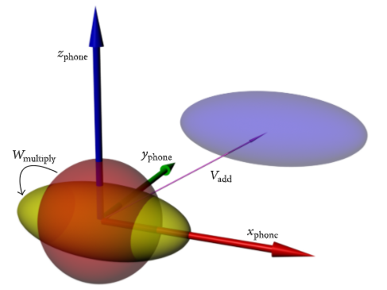
Literature Review – Magnetic field magnitude based positioning - DAME
Indoor magnetic field is a pervasive anomaly induced by a geomagnetic field due to its stable and infrastructure-free feature
Smartphones are one of the commonly used applications for magnetic field positioning: collecting the indoor magnetic field signal by the magnetometer
Major Challenge
Magnetic field would interfere with hard/soft-iron effect, hand squeakers, and electronic noise, which are not location-related. These interferences deteriorate the distinguishability of location fingerprints in magnetic field-based localization systems
DAME Solution
DAME, a novel fingerprint distinguishability measurement method, especially suitable for low discernibility MFM fingerprint, is proposed to extract location features
Soft and hard-iron effect illustration
Notes:
Trilateration = range-based

Slide 9
Literature Review – Dropout as a Bayesian Approximation
Deep learning tools regression and classification instruments do not capture model uncertainty.
Bayesian models have a mathematically based framework to illustrate the model uncertainty, but it comes with huge cost
Deep neural network(NNs) as approximate Bayesian inference in deep Gaussian processes which eliminates the uncertainty of deep learning without compromising the complexity and test accuracy
Multiple network architectures and nonlinearities are evaluated for regression and classification, using MNIST as an example
Notes:
Trilateration = range-based

Slide 10
Problem of previous work
Previous research works have emphasized the combination of various kinds of signal and putting their strength together while avoiding the weakness. However, within the previous research work and papers, only a limited number of signals are fused. Simultaneously, a customized and focused framework based on the nature and characteristics of a set of specific signals has been adopted. Adjustments had also been made to compromise the specific signal combinations. With such changes and manipulations, the extension towards other signals is hardly accessible and sometimes impossible
Moreover, there are assumptions that all the signals are completely available during localization decisions. However, this is not the case in real life, with broadly variating sampling rates, loss of signal values results. Compensation methods might have adopted the last measured ones by conducting predictions based on records and history or even reducing localization frequency to the slowest sampling rate. Such methods are not desirable

Slide 11
Challenges of a robust fusion system
Firstly, a robust fusion system's algorithms have been designed for a particular set of signal forms and combinations. This could not be generalized into algorithms that suit all kinds of different signal combinations. When customization is adopted and applied, the algorithms may not function normally when some signals within the combination are unavailable. Such straight limitation is undesirable and crucial to the effectiveness and functionality of the system
Secondly, a wide range of operational environments of a robust fusion system, making changes and fixing codes will be tedious as various operational environments with different structures have to be addressed. Heavy resources are needed in order to make small changes and amendments. With this challenge, the system could not be considered exhaustive. A unified approach is needed to address this issue
Finally, the data is scarce. In order to collect enough data, tremendous survey efforts and resources are required. It is not affordable and practical to collect such unreasonably large amounts of data to build a robust algorithm

Slide 12

implementation

Slide 13

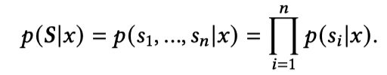
Implementation – sifu framework
Fig.1. The architecture of siFu framework
siFu adopts a probabilistic framework as illustrated in Fig. 1. Different localization algorithms are designed for a specific signal according to their signal characteristics and performance
the spatial likelihood is put as input to the neural network, as a deep learning system can learn the noisy distribution produced by localization algorithms.
by assuming conditional independence among various signals, we can compute the likelihood P(S|x) by

Slide 14
Implementation – Challenges during the architecture design phase
Challenges when deploying Generative Adversarial Network(GAN) framework
The generator did not converge in most of the cases, which shows its instability when it is utilized in localization problems which are highly noisy for the inputted signal.
The accuracy performance is not satisfactory as expected. I have tried several state-of-art GAN frameworks such as DCGAN(Deep Convolutional GAN) and Tensor-GAN. But they did not improve the accuracy of the previous Autoencoder model.
After our further analysis on the model details, we believe that the GAN model may overfit to the training data, thus giving poorer results for unseen testing data.

Slide 15
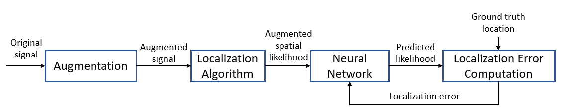
Implementation – revamped architecture implementation
Fig. 2. Revamped localization architecture with data augmentation module
We observed that each element in a signal vector has a correlation with its neighbor element, we proposed Conv1D network to extract this relationship in the signal series. Conv1D network is made up of three convolution layers with a completely connected layer.
We also proposed an augmentation module, making the siFu framework robust to altered signals. We use data augmentation techniques that allow the model to robust to the swapped APs/ removed APs etc.
Moreover, Monte-Carlo method is used to estimate the posterior distribution P(W|D), and use it to check whether D is in our learnt distribution, then retrieving the value of epistemic uncertainty, which is the uncertainty existing in our model

Slide 16

experimental results

Slide 17
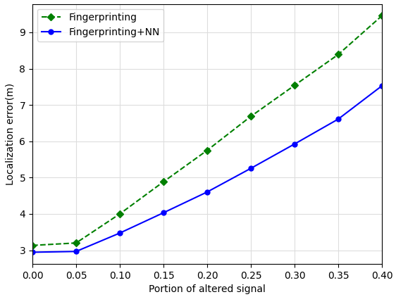
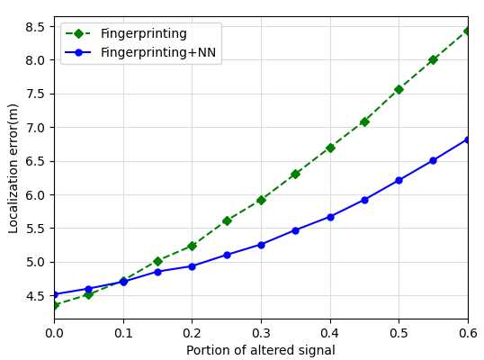
Experimental result – experiment 1
I performed site visits in LTA to LTB(semi-indoor space) and 2F corridors(indoor area) at HKUST using the given android app to collect sensor signals. Conv1D network with customized data augmentation is used to handle WiFi and magnetic signals.
There are 93 APs in the indoor open space, and 91 APs in the 2F corridors area. A mixture of different signals is handled using the siFu framework in the indoor open area, including Google API, WiFi, magnetic, and BLE signals. Here,Wifi and magnetic signals are selected to illustrate the experimental result since they are generally available in the indoor area.
Fig. A: Wi-fi Fingerprinting at 2F corridors
Fig. B: Wi-fi Fingerprinting at LTA area

Slide 18
Experimental result – experiment 1(Con’d)
Fig. A: Wi-fi Fingerprinting at 2F corridors
Fig. B: Wi-fi Fingerprinting at LTA area
In the above graphs, the localization errors of using the traditional cosine similarity method and using the Conv1D network are plotted against the portion of altered signal. The portion of altered signal is a variable to control the noise level used in each data augmentation method. It can be observed that using the Conv1D network has a lower localization error of around 26% at 40% signal altered level compared to using the traditional cosine similarity method.
In the first experiment of using a WiFi signal to test the Conv1D network, the result was satisfactory.

Slide 19
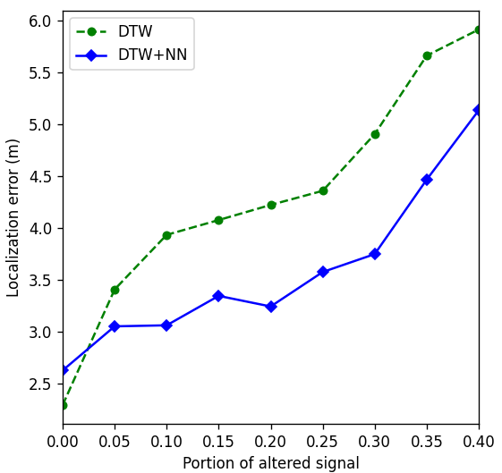
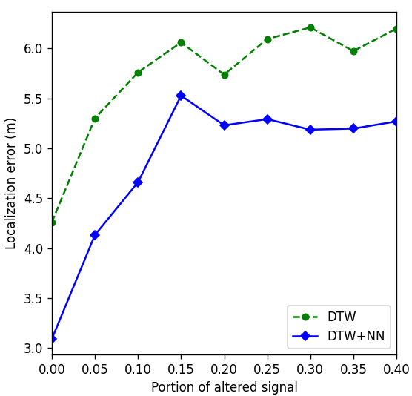
Experimental result – experiment 2
Fig. C: Magnetic Signal at 2F corridor
Fig. D: Magnetic Signal at LTA area
It is compared with the DTW algorithm which is responsible to estimate the similarity between two time series. It can be observed that using the Conv1D network has a lower localization error of around 20% at 40% signal altered level compared to using the traditional DTW method. Moreover, the average difference between DTW algorithm and the Conv1D in magnetic field signals is larger than the difference in the WiFi signal by around 14%. This implies that using Conv1D in the magnetic field has a more significant improvement compared to WiFi signal testing.
In the second experiment of using the magnetic signal to test the Conv1D network, the result was also satisfactory.

Slide 20
Thank you!

